Slide 1


IABiLSTM-NET on Solar Cell Detection using Thermal Image
Project Presentation & Defense
Major：Computer Science Supervisor：Dr. Happy Nkanta Monday
Student ID：202118010407 Author：Rui Gao

Slide 2
Contents
01
02
03
04
Introduction
Dataset
Methodology
Result Analysis
05
06
07
08
GUI Deployment
Conclusion
Future Work
Limitation

Slide 3
01
Introduction

Slide 4
Introduction
Background
Importance: solar energy is a renewable energy, which include extended lifespan, sustainability, low-noise performance and cleanliness advantages [1].
Defects Influences: defects can negatively impact the efficiency and performance of the solar panels.
Traditional methods: include the manual inspection and visible light imaging detection.
Advanced methods: combining advanced machine learning techniques with thermal imaging.
Industry Background
Detection Methods

Slide 5
Introduction
Background
Aim
Audience
develop a deep learning classification model that combines Inception, Attention and BiLSTM to detect defects in solar panels.
Solar energy companies and operators
Countries and governments
Consumers of solar energy
Environmental organizations
Scope
reduced maintenance costs
improved performance
sustainability

Slide 6
02
Dataset

Slide 7
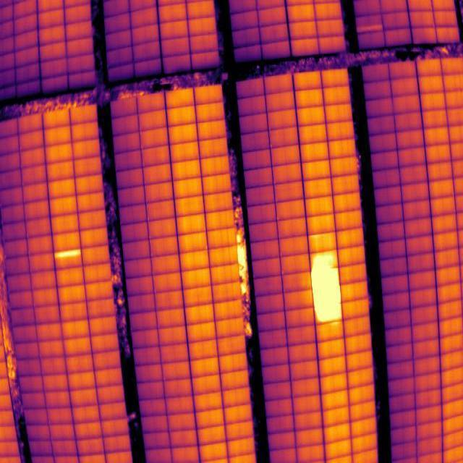
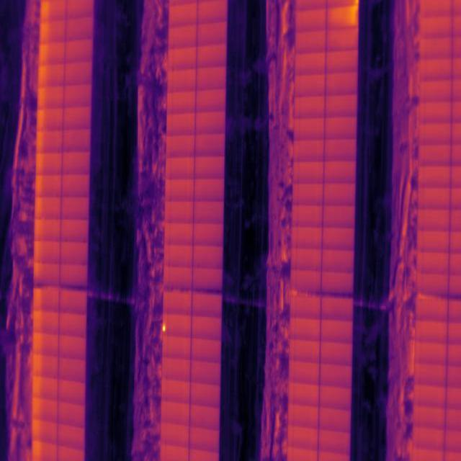
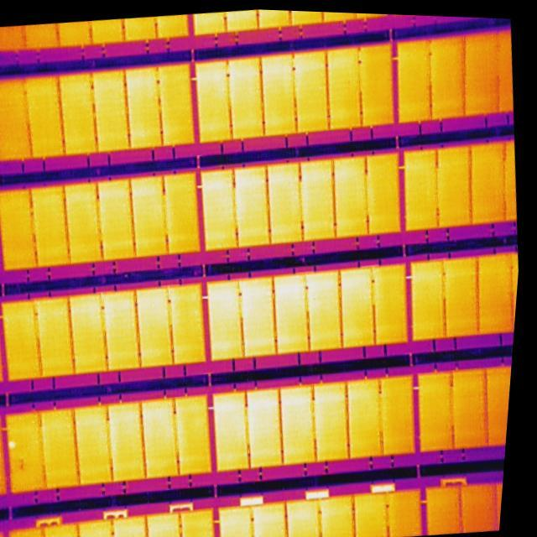


Dataset
Information
Figure 1. Dataset image
Figure 2. Dataset image
Figure 3. Dataset image
Dataset Source
Dataset Name
Dataset Details
Obtained from Roboflow Universe
PV Failure Detector
Images: 5,352 thermal images (4, 733 defective and 619 non-defective)
Annotation Format: Pascal VOC (XML files)
Size: 640×640
Annotation label: thermal defects

Slide 8
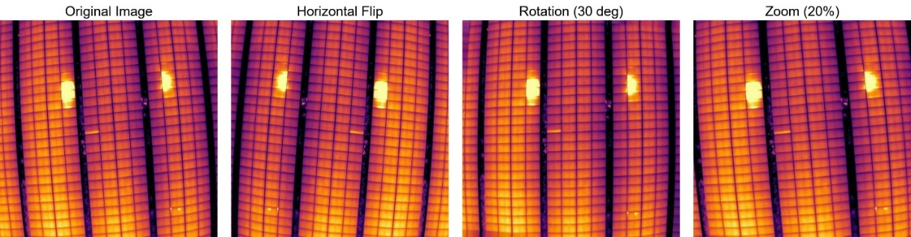
Dataset
Preprocessing
Separation
Augmentation
Three split radio:
80:10:10
70:20:10
60:20:20
Rescaling
Random Rotation
Width Shift
Height Shift
Shear Transformation
Zooming
Horizontal Flip
Separation
Augmentation
Resize & Rename
Resize the pixels to 128 * 128
Rename the image name in the format: {set name}_{number}
Resize & Rename
Figure 4. Examples of data augmentation

Slide 9
03
Methodology

Slide 10
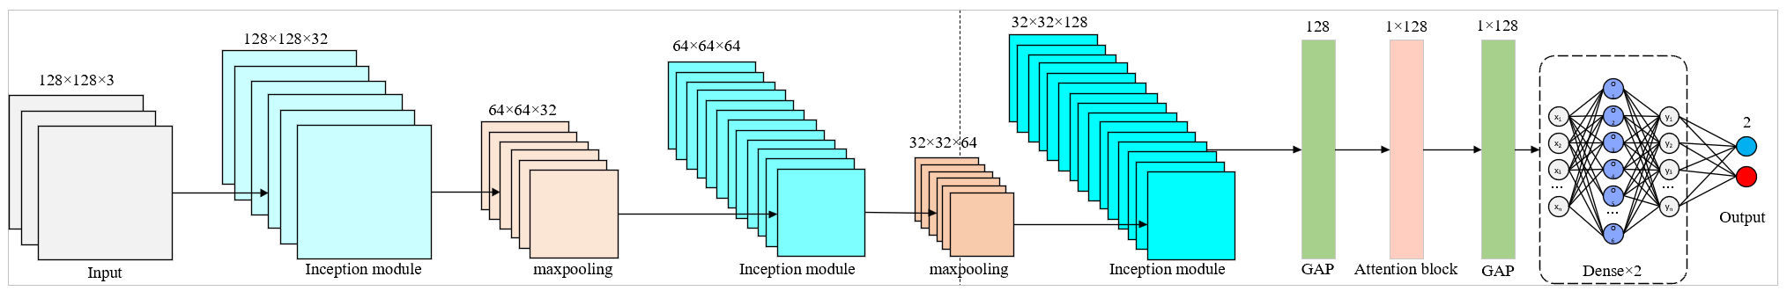
Methodology
Proposed Model
Figure 5. Architecture of proposed model
Inception Module
Attention Block
BiLSTM Module
The key idea of the Inception module is to use multiple filter sizes, then concatenate them along with the output of the max-pooling layer and pass them to the next layer [2].
A technique that enables neural networks to “selectively” concentrate on the most relevant parts of the input data [3].
Simultaneously learning features in both the forward and backward directions of the sequence to capture more information.

Slide 11
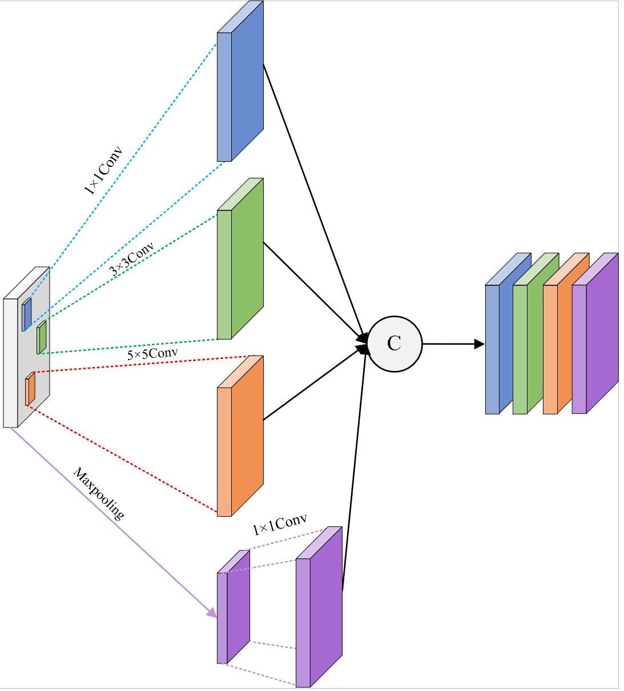
Methodology
Inception Module
Input
Four Branches
1 x 1 Conv
3 x 3 Conv
5 x 5 Conv
Maxpooling
Output
Concatenate
Figure 6. Architecture of Inception module in proposed model

Slide 12
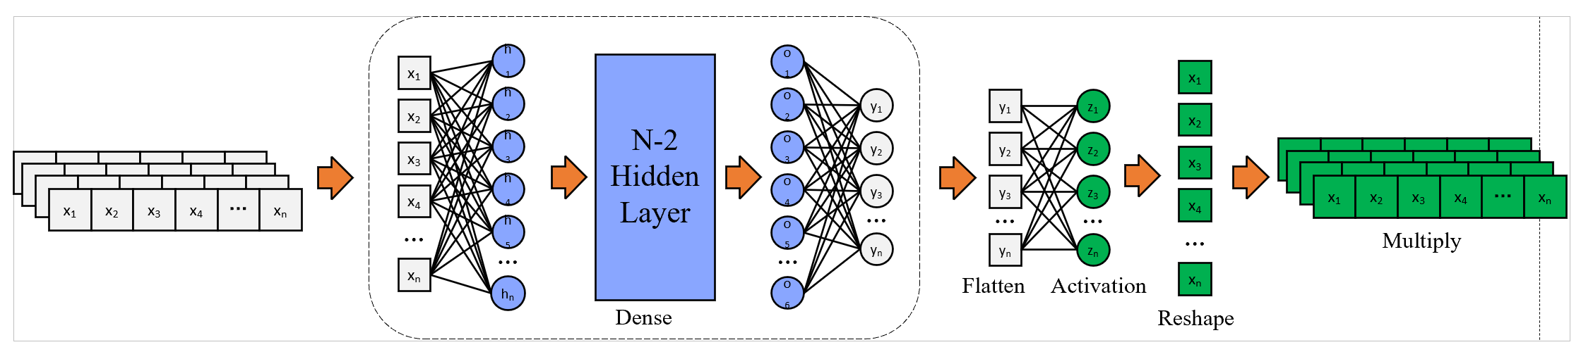
Methodology
Attention Block
Figure 7. Architecture of Attention Block in proposed model
BiLSTM Output
Attention Score
Attention Weights × Original Features
(Softmax Normalization)
点击此处添加文本内容，如关键词、部分简单介绍等。点击此处添加文本内容，如关键词、部分简单介绍等。
Focused Feature Output

Slide 13
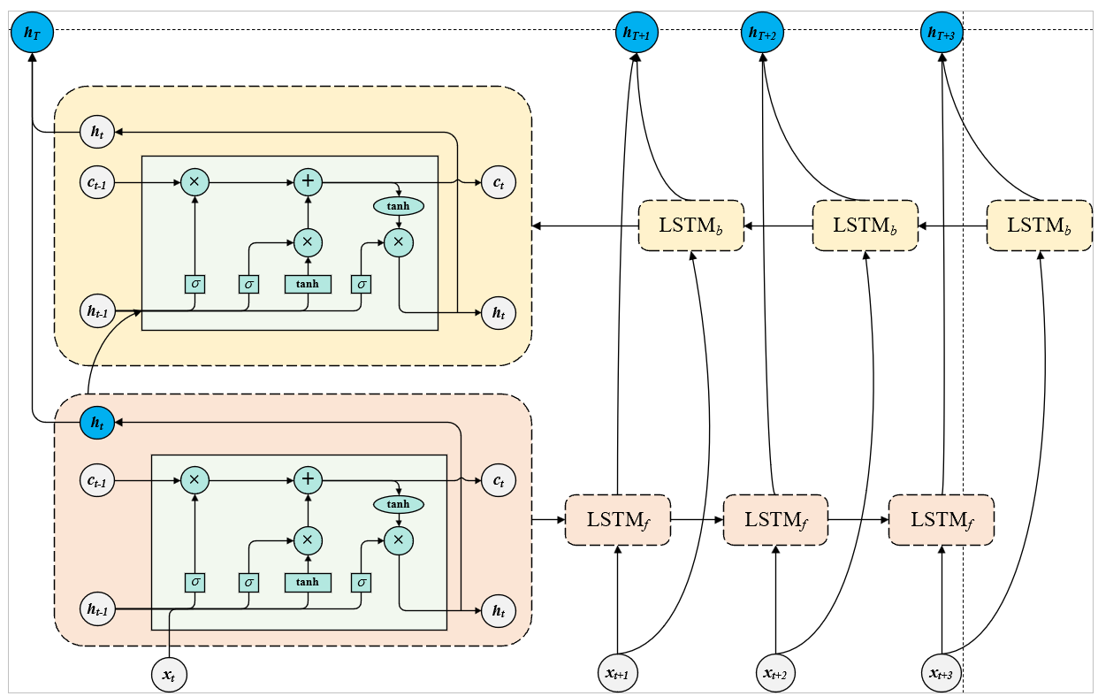
Methodology
BiLSTM Module
Reshape Layer
Bidirectional BiLSTM Layer
(64 BiLSTM units)
Dropout Layer
(Randomly drops 30% neurons)
Figure 8. Architecture of BiLSTM module in proposed model

Slide 14
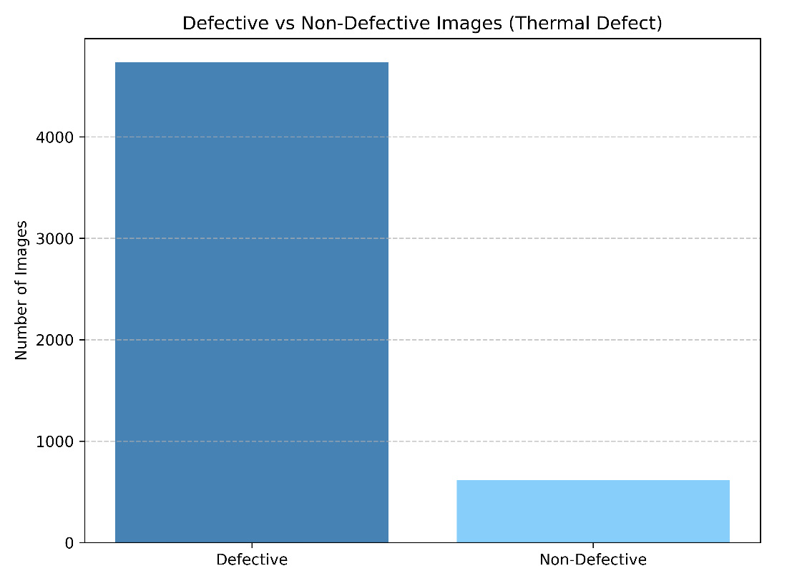
Methodology
Focal Loss Function
Focal loss is one of the popular ones in dealing with class imbalance problems as well as improving learning speed [4].
Its purpose is to address the problem of class imbalance.
Defective：4733
Non-Defective：619
Figure 9. Class Balance Comparison

Slide 15
04
Result Analysis

Slide 16
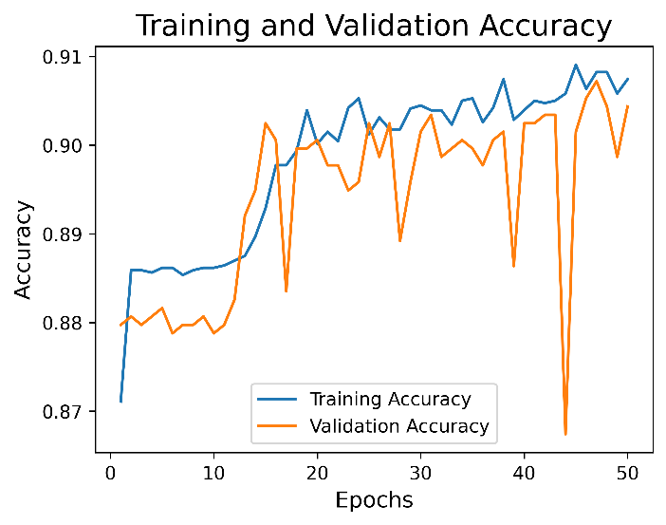
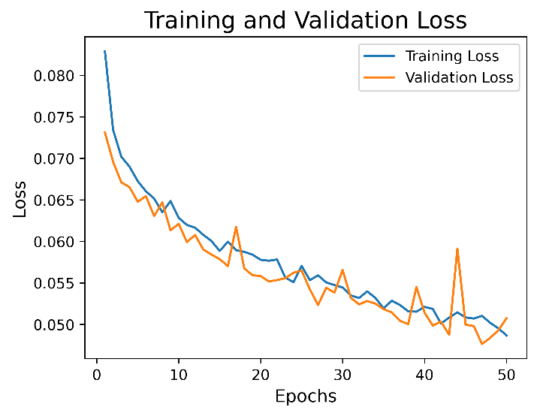
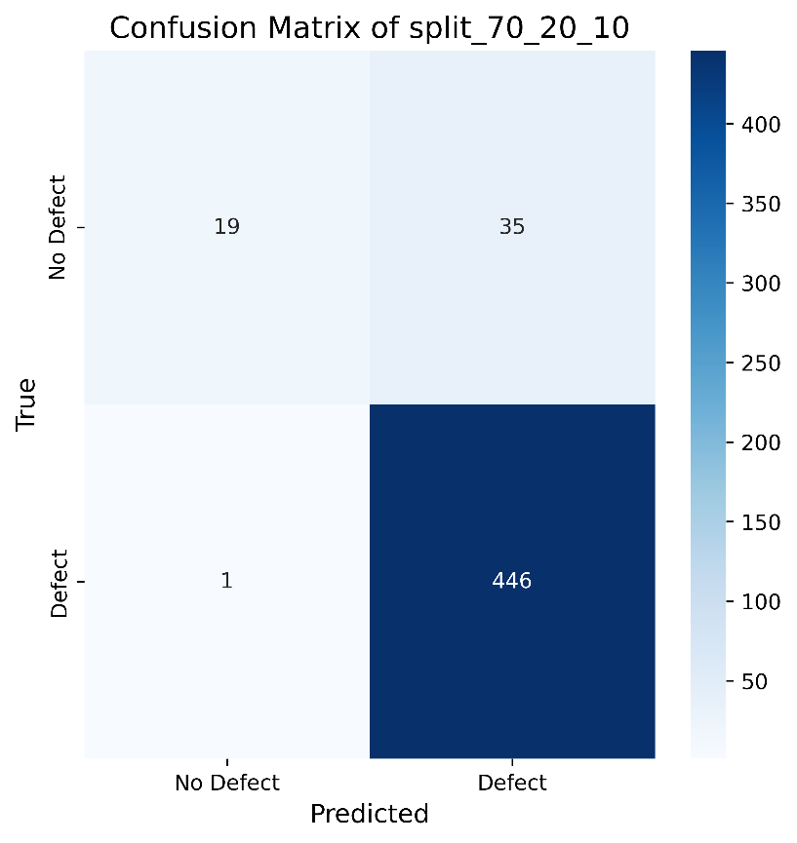
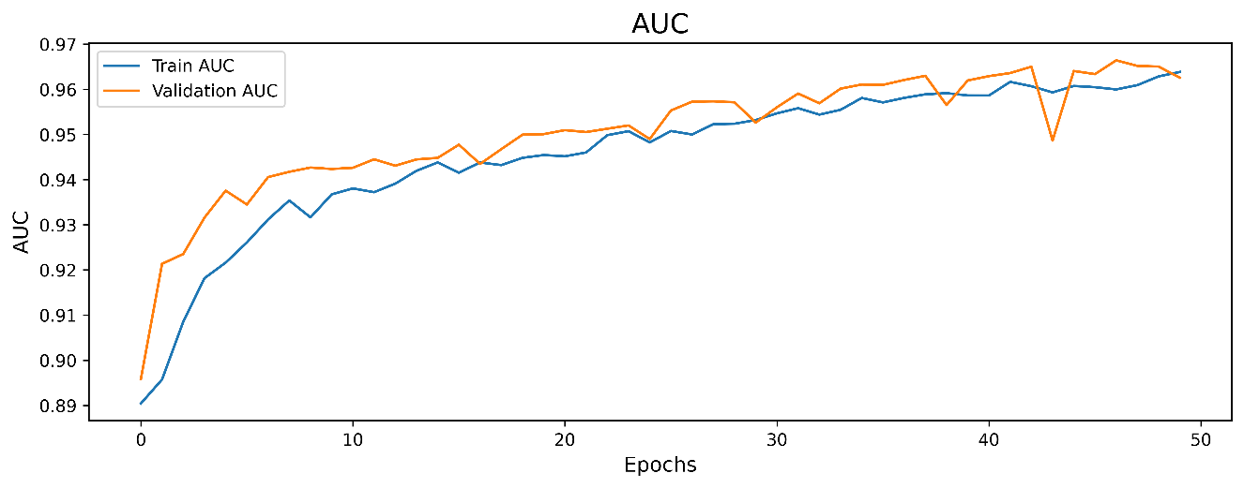
Result Analysis
Best Split Ratio 70:20:10
Figure 10. Accuracy Curve
Figure 11. Loss Curve
Figure 13. Confusion Matrix
Figure 12. AUC Curve

Slide 17
Result Analysis
Comparison
Overall Comparison of three split radios
Split Ratio | Accuracy | Loss | Precision | Recall/Sensitivity | AUC | Specificity | F1-Score
80:10:10 | 0.9142 | 0.0456 | 0.9142 | 0.9142 | 0.9684 | 0.3898 | 0.9540
70:20:10 | 0.9156 | 0.0464 | 0.9156 | 0.9156 | 0.9677 | 0.3518 | 0.9533
60:20:20 | 0.8870 | 0.0559 | 0.8870 | 0.8870 | 0.9544 | 0.3284 | 0.9392
Table 1. Overall Comparison of three split radios
Overall Comparison of four models
Model | Accuracy | Loss | Precision | Recall/Sensitivity | AUC | Specificity | F1-Score
Proposed | 0.9156 | 0.0464 | 0.9156 | 0.9156 | 0.9677 | 0.3519 | 0.9533
Inception | 0.9043 | 0.0492 | 0.9043 | 0.9043 | 0.9651 | 0.2241 | 0.9550
Inception_Attention | 0.9193 | 0.0460 | 0.9193 | 0.9193 | 0.9697 | 0.3442 | 0.9633
CNN | 0.9118 | 0.0556 | 0.9118 | 0.9118 | 0.9565 | 0.2787 | 0.9581
Table 2. Overall Comparison of four models

Slide 18
05
GUI Deployment

Slide 19
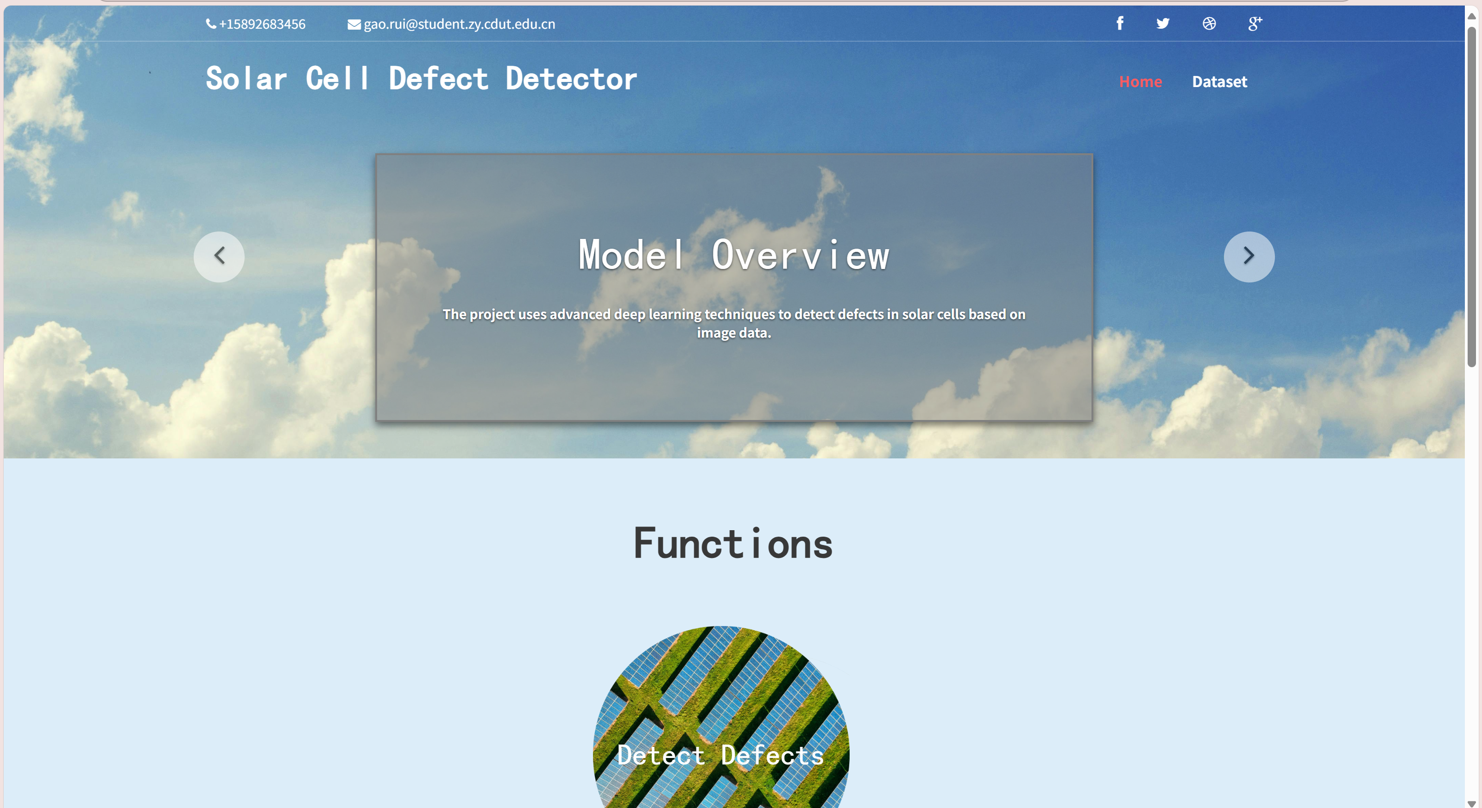
GUI Deployment
Homepage
Figure 14. Homepage of GUI

Slide 20
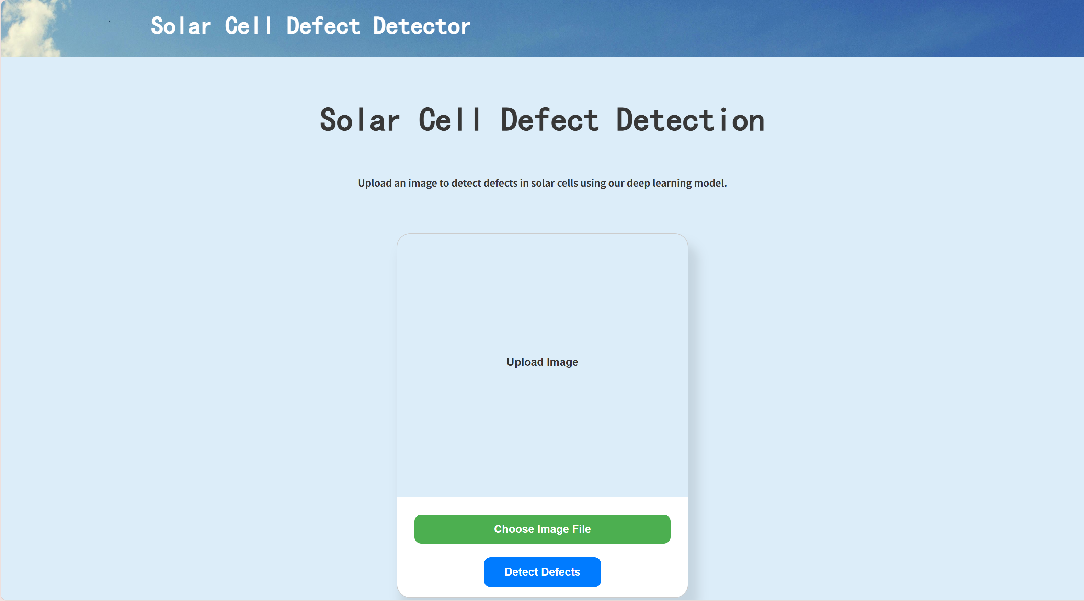
GUI Deployment
Function
Step 1: Click this button to choose the image
Step 2: Click this button to start detection
Figure 15. Function page of GUI

Slide 21
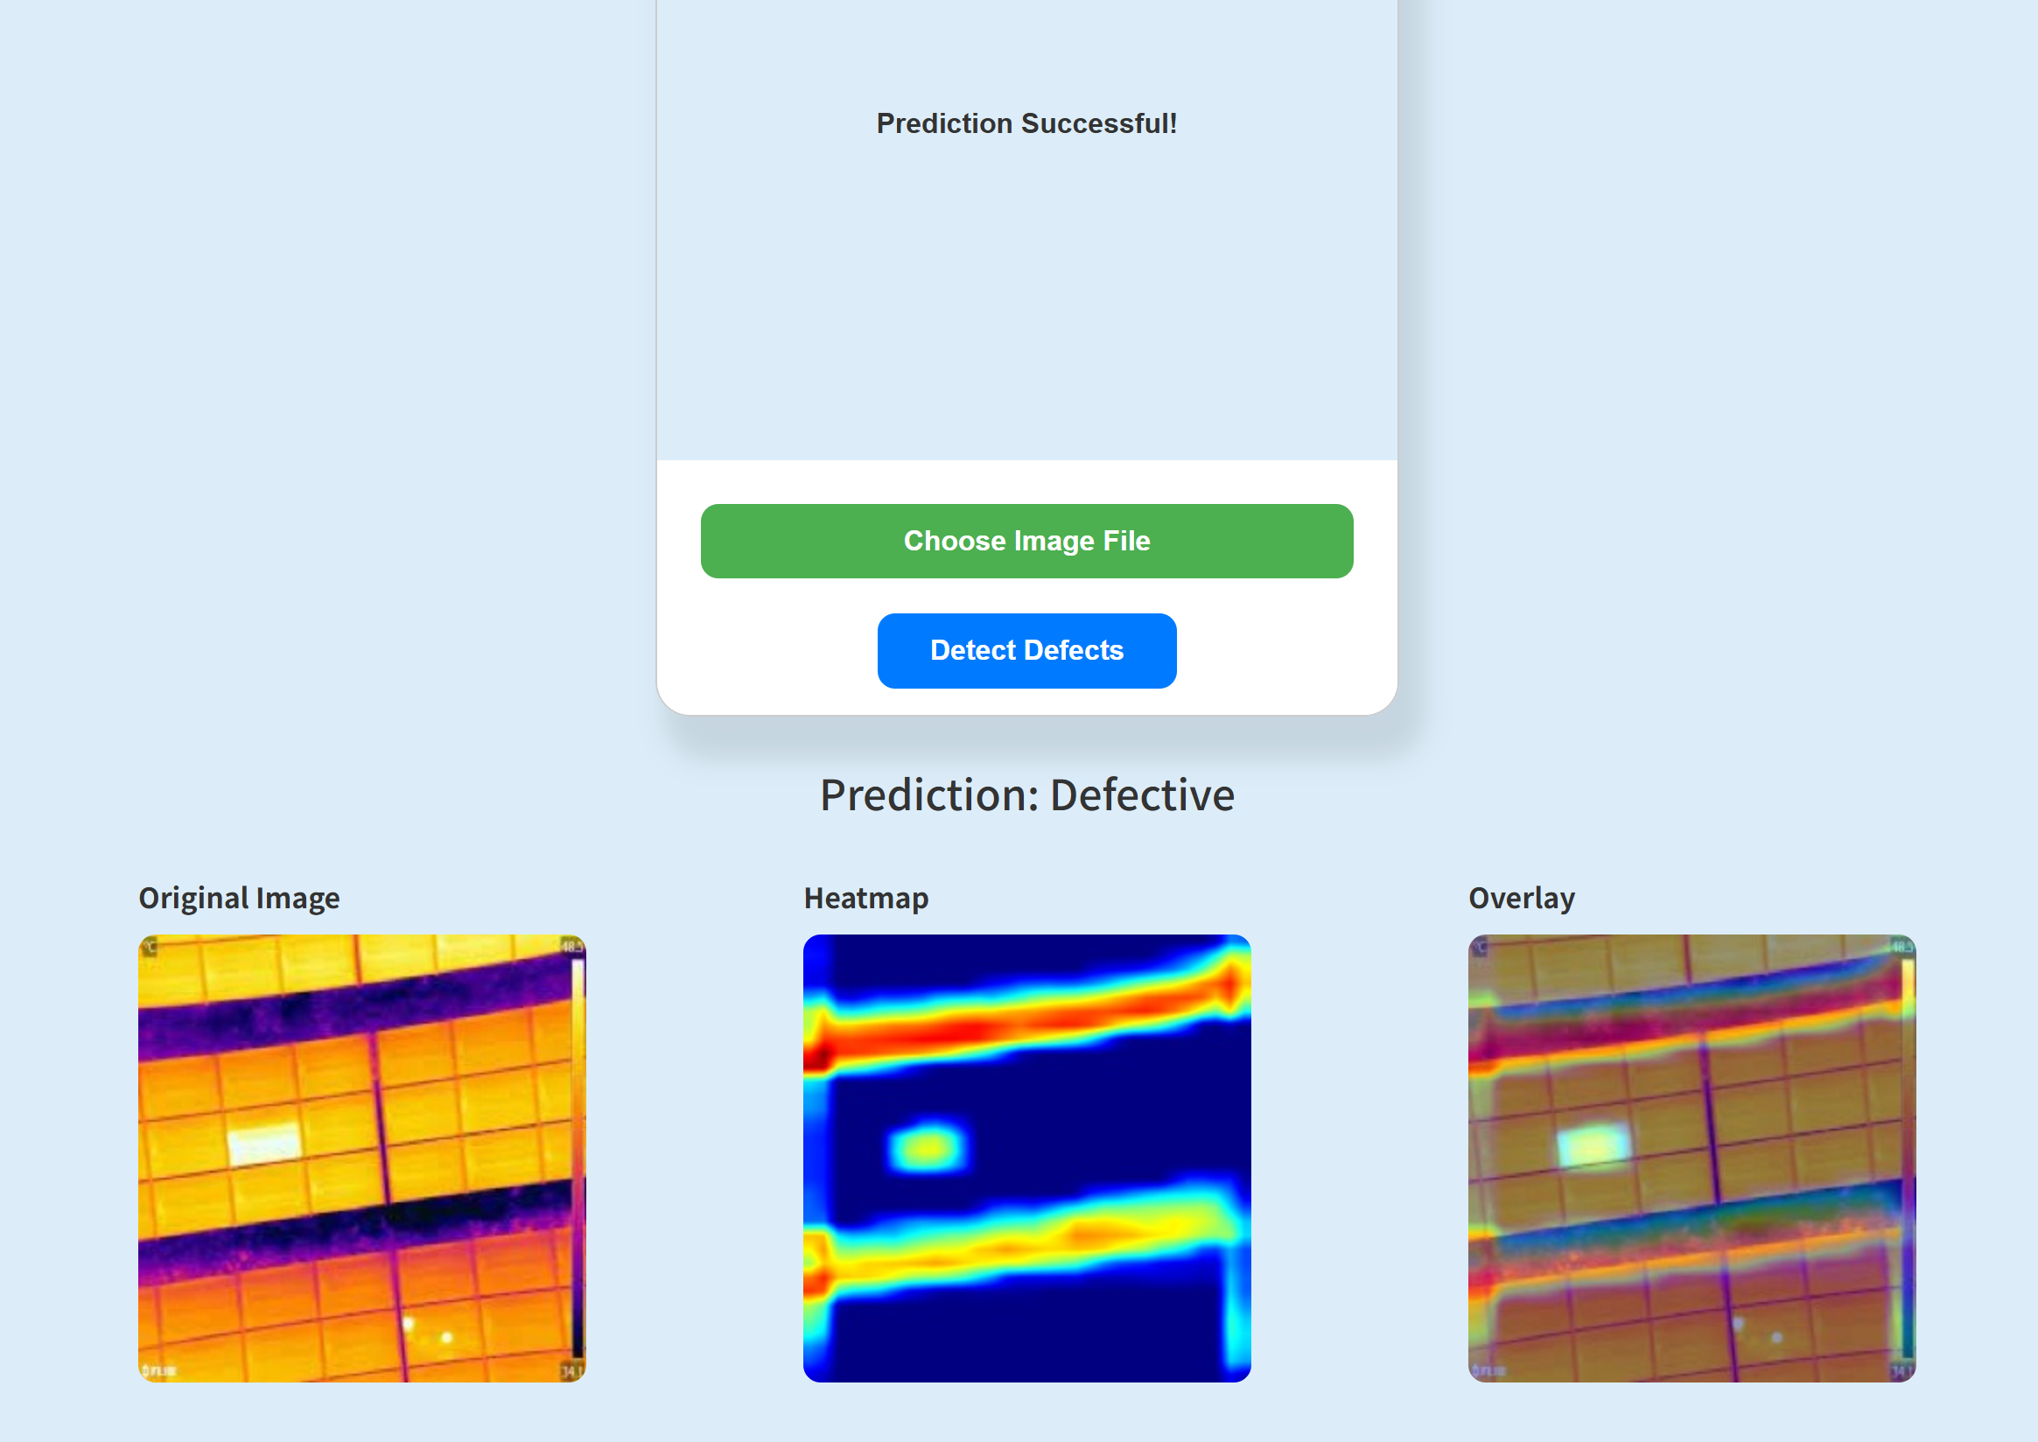
GUI Deployment
Detection Result
Figure 16. Detection Result of GUI

Slide 22
06
Conclusion

Slide 23
Conclusion
This research designs and implements a high-performance deep learning model for photovoltaic panel defect detection, which integrates Inception modules, attention mechanisms, and BiLSTM networks to achieve better feature extraction, sequential learning, and focus on important information. The following works were completed in this project:
Deep learning model architecture design
Data preprocessing and augmentation strategies
Model performance evaluation
Comparative experiments with three models
Deployment of a simple and user-friendly detection interface
In conclusion, the project demonstrates the strong potential of deep learning techniques for defect detection in solar panel thermal imaging.

Slide 24
07
Limitation

Slide 25
Limitation
Limited dataset diversity and size.
Model performance may vary in real-world scenarios.
Dependency on labeled data for training.
Computationally expensive for large-scale deployment.
Lack of real-time system testing in field conditions.

Slide 26
08
Future Work

Slide 27
Future Work
Expand dataset with diverse defects.
Use advanced attention mechanisms.
Explore lightweight models
for edge devices.
Investigate self-supervised learning
Integrate temperature and metadata.
Develop an end-to-end monitoring system.

Slide 28
Reference
[1] A. Shaik, A. Balasundaram, L. S. Kakarla, and N. Murugan, “Deep Learning-Based Detection and Segmentation of Damage in Solar Panels,” Automation, vol. 5, no. 2, pp. 128–150, May 2024, doi: 10.3390/automation5020009.
[2] T. Barakbayeva and F. M. Demirci, “Fully automatic CNN design with inception and ResNet blocks,” Neural Comput. Appl., vol. 35, no. 2, pp. 1569–1580, Jan. 2023, doi: 10.1007/s00521-022-07700-9.
[3] G. Brauwers and F. Frasincar, “A General Survey on Attention Mechanisms in Deep Learning,” IEEE Trans. Knowl. Data Eng., vol. 35, no. 4, pp. 3279–3298, Apr. 2023, doi: 10.1109/TKDE.2021.3126456.
[4] M. Kerkhof, L. Wu, G. Perin, and S. Picek, “Focus is Key to Success: A Focal Loss Function for Deep Learning-Based Side-Channel Analysis,” in Constructive Side-Channel Analysis and Secure Design, vol. 13211, J. Balasch and C. O’Flynn, Eds., in Lecture Notes in Computer Science, vol. 13211. , Cham: Springer International Publishing, 2022, pp. 29–48. doi: 10.1007/978-3-030-99766-3_2.

Slide 29
Thank you all for your listening!

